Slide 1
Python final project
BY
Adam Goodrich

Slide 2


The company I work for uses Google Sheets for a lot of stuff
MANIPULATED WITH
I think that a lot of the processes could be automated with python

Slide 3

One of the most time consuming things I do is billing for our largest client

Slide 4
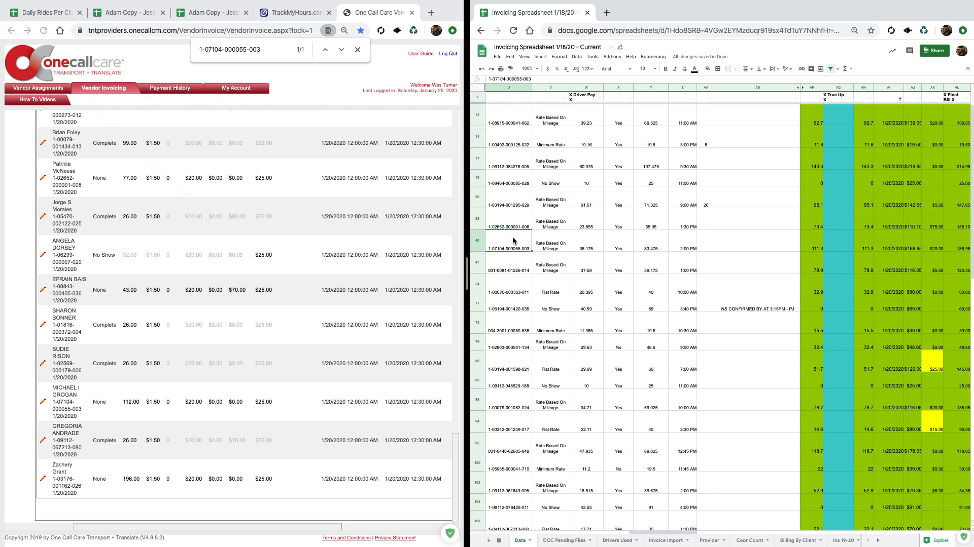
Here is a sample of how that process goes

Slide 5
Seems time consuming huh…

Slide 6
My Hypothesis:
These things can be copied to a CSV File and then manipulated with python to automate a lot of my workflow

Slide 7
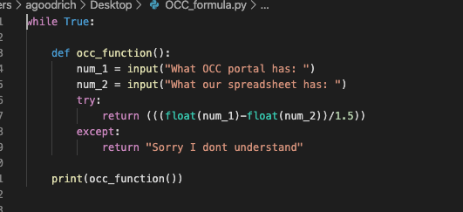
Here is a small function I wrote to help me

Slide 8
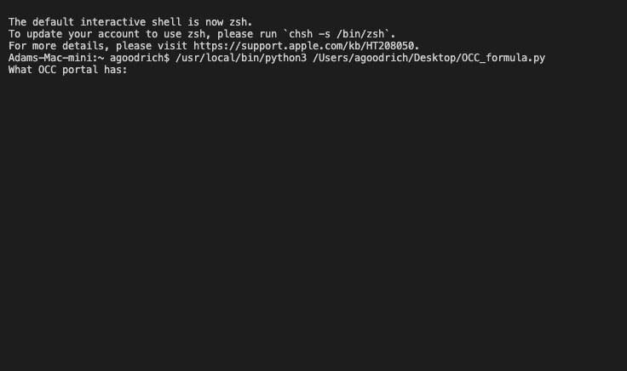
Here it is in action
I am entering what they have on their portal
Then what we have on our spreadsheet
Then I use the result and copy paste it onto the spreadsheet.
There is a While True Loop to keep it going forever.

Slide 9
My goal is to automate as much as possible
At the very least I would like a python program analyze all the files and give me mileage true up number using the formula from my occ_function().
Some things that would be amazing if I could accomplish are:
Manipulating the portal to input the data for me
(example: changing status and entering wait time details)
Removing files that need further investigation
Putting those files into a doc that I can send to our client
A bonus would be to get some data from these to analyze and bring to my bosses

